Slide 1

Algorithms and Data Structures 1 CS 0445
Fall 2023
Average-case Analysis, Amortized Analysis,
ADT Queue
Sherif Khattab
ksm73@pitt.edu
(Slides adapted from slides of Textbook, Dr. Ramirez’s CS 0445, and Dr. Farnan’s CS 1501)

Slide 2
Announcements
Upcoming Deadlines
Assignment 5: Friday 12/8 @ 11:59 pm
Homework 12: Tuesday 12/12 @ 11:59 pm

Slide 3
Final Exam
Friday 12/15 noon-1:50 pm
Same format as midterm
Non-cumulative
Same classroom as lectures
Study guide and practice test on Canvas
Final Review in this week’s recitations

Slide 4
Bonus Opportunities
Bonus Lab: Monday 12/18 @ 11:59 pm – up to 1%
Bonus Homework: 12/18 @ 11:59 pm – up to 0.5%
OMETs Bonus: 1% for entire class
when OMETs response rate >= 80%
Currently at 39%
Deadline is Sunday 12/10

Slide 5
Another approach: Boyer Moore
What if we compare starting at the end of the pattern?
t = ABCDVABCDWABCDXABCDYABCDZ
p = ABCDE
V does not match E
Further V is nowhere in the pattern…
So skip ahead m positions with 1 comparison!
Runtime?
In the best case, n/m
When searching through text with a large alphabet, will often come across characters not in the pattern.
One of Boyer Moore’s heuristics takes advantage of this fact
Mismatched character heuristic

Slide 6
Mismatched character heuristic
How well it works depends on the pattern and text at hand
What do we do in the general case after a mismatch?
Consider:
t = XYXYXYZXXXXXXXXXXXXXX
p = XYXYZ
If mismatched character does appear in p, need to “slide” to the right to the next occurrence of that character in p
Requires us to pre-process the pattern
Create a right array
for (int i = 0; i < R; i++)
right[i] = -1;
for (int j = 0; j < m; j++)
right[p.charAt(j)] = j;
Pattern: A B C D E
right = [0, 1, 2, 3, 4, -1, -1, … ]

Slide 7
Mismatched character Procedure
Let j be the index in the pattern currently under comparison
At mismatch, slide pattern to the right by
j - right[mismatched_text_char] positions
If < 1, slide 1

Slide 8
Mismatched character heuristic example
Text: A B C D X A B C D C A B C D Y A E C D E A B C D E
A B C D E
A B C D E
A B C D E
A B C D E
A B C D E
A B C D E
Pattern: A B C D E
A B C D E
right = [0, 1, 2, 3, 4, -1, -1, … ]
Notes:
Procedure:
Let j be the index in the pattern currently under comparison
At mismatch, slide pattern j - right[mismatched_text_char]
If < 1, slide 1
Time space tradeoff here:
Only storing so much information about the pattern
Means we sometimes only slide one character when we could have slid more

Slide 9
Runtime for mismatched character
What does the worst case look like?
Runtime:
Θ(nm)
Same as brute force!
This is why mismatched character is only one of Boyer Moore’s heuristics
Another works similarly to KMP
See BoyerMoore.java
Notes:
Similar worst case to brute force
However, the mismatched character in the pattern is now on the right side rather than the left
t = XXXXXXXXXXXXXXXXXXXXXXXXXXXXX p = YXXXXX

Slide 10
Another approach: Rabin Karp
Hashing was cool, let's try using that
public static int hash_search(String pat, String txt) {
int m = pat.length();
int n = txt.length();
int pat_hash = h(pat);
for (int i = 0; i <= n - m; i++) {
if (h(txt.substring(i, i + m)) == pat_hash)
return i; // found!
}
return n; // not found
}

Slide 11
Well that was simple
Is it efficient?
Nope! Practically worse than brute force
Instead of nm character comparisons, we perform n hashes of m character strings
Can we make an efficient pattern matching algorithm based on hashing?

Slide 12
Horner’s method
Brought up during the hashing lecture
public long horners_hash(String key, int m) {
long h = 0;
for (int j = 0; j < m; j++) h = (R * h + key.charAt(j)) % Q;
return h;
}
horners_hash("abcd", 4) =
'a' * R³ + 'b' * R² + 'c' * R + 'd' mod Q
horners_hash("bcde", 4) =
'b' * R³ + 'c' * R² + 'd' * R + 'e' mod Q
horners_hash("cdef", 4) =
'c' * R³ + 'd' * R² + 'e' * R + 'f' mod Q

Slide 13
Efficient hash-based pattern matching
text = "abcdefg"
pattern = "defg"
This is Rabin-Karp
Notes:
no time for v this v add to slide?
Run as a classroom exercise, either small group or all together depending on time.
Result:
m = pattern.length
ph = horners_hash(text, m)
th = horners_hash(pattern, m)
i = 0
while ph != th:
th -= pattern[i] * R^{m}
th *= R
th = (th + pattern[i + m]) % Q
i++

Slide 14
What about collisions?
Note that we’re not storing any values in a hash table…
So increasing Q doesn’t affect memory utilization!
Make Q really big and the chance of a collision becomes really small!
But not 0…
OK, so do a character by character comparison on a hash match just to be sure
Worst case runtime?
Back to brute force esque runtime...
Notes:
Do we want to use perfect hashing?
No! means huge hash values, meaning need to store in BigInteger, meaning expensive hash comparisons
Hence, we need a Q, can just be really large
E.g., MAXINT would be too big for a hash table (>4000000000 entries), but keeps hash values small enough for efficient comparisons

Slide 15
Assorted casinos
Two options:
Do a character by character comparison after hash match
Guaranteed correct
Probably fast
Assume a hash match means a substring match
Guaranteed fast
Probably correct
Las Vegas
Monte Carlo
Notes:
notes/discussion:
looking for the same pattern a bunch? amortized cost to generating dfa
looking over the same text all the time? amortized cost generating complete hash list of whole text
or other search structure

Slide 16
Worst-case Runtime of Iterative Insertion Sort
Insertion Sort: at iteration i, insert a[i] into sorted subarray of first i entries
two nested loops:
outer loop: 1 → n-1 → n-1 iterations
inner loop: i comparisons in the worst case
i = 1 → 1 comparison
i = 2 → 2 comparisons
i = 3 → 3 comparisons
…
i = n-1 → n-1 comparisons
Total # comparisons = 1 + 2 + 3 + … + n-1 = O(n²)

Slide 17
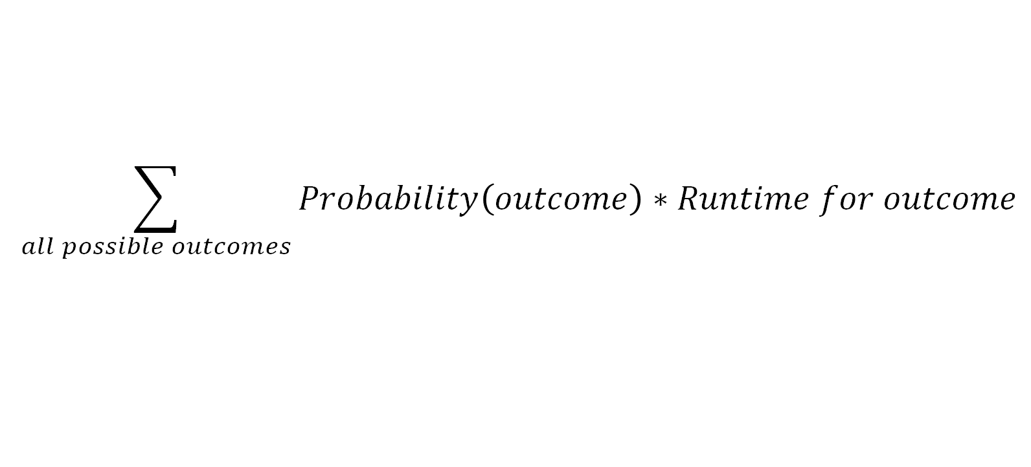
Runtime of Sequential Search
Sequential Search: Check array/chain entries sequentially
Runtime of Sequential Search
Best case: 1 comparison (when?)
Worst case: n comparisons (when?)
Average case: somewhere between best and worst cases
Average-case Runtime
$$\sum_{all possible outcomes}{Probability\left(outcome\right)∗Runtime for outcome}$$

Slide 18
Average-case Analysis of Sequential Search
Possible Outcomes:
target not found
target found at index 0, 1, 2, …, n-1
n+1 possible outcomes
Let's assume that all outcomes are equally likely
The probability of outcome i = P(i) = 1/(n+1) for any i
Analysis possible given probability distribution for the outcomes
We will count comparisons
target not found
→ n comparisons
target found at index 0
→ 1 comparison
target found at index 1
→ 2 comparisons
target found at index i
→ i+1 comparisons

Slide 19
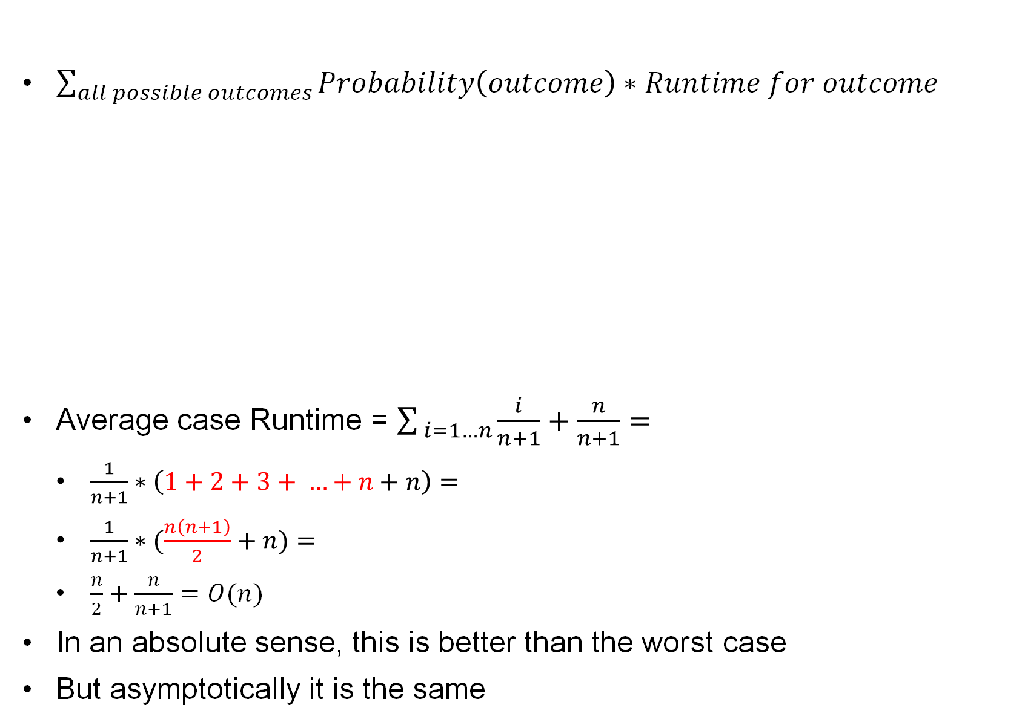
Average-case Analysis of Sequential Search
$\sum_{all possible outcomes}{Probability\left(outcome\right)∗Runtime for outcome}$
Average case Runtime = $\sum_{ i=1…n}{\frac{i}{n+1}+\frac{n}{n+1}}=$
$\frac{1}{n+1}∗\left(1+2+3+ …+n+n\right)=$
$\frac{1}{n+1}∗(\frac{n\left(n+1\right)}{2}+n)=$
$\frac{n}{2}+\frac{n}{n+1}=O(n)$
In an absolute sense, this is better than the worst case
But asymptotically it is the same
Outcome | Probability | Runtime | Probability*Runtime
Item not found | 1/(n+1) | n | n/(n+1)
Item found at index 0 | 1/(n+1) | 1 | 1/(n+1)
Item found at index 1 | 1/(n+1) | 2 | 2/(n+1)
…
Item found at index n-1 | 1/(n+1) | n | n/(n+1)

Slide 20

Average-case Analysis of Quick Sort
Consider the items in sorted order
Consider any two items C_{i} and C_{j}
at position i and j in the sorted order, i < j
Key observation: C_{i} and C_{j} are compared if and only if one of them is pivot before any of the items between them in sorted order
If an item between C_{i} and C_{j} is pivot before them
C_{i} and C_{j} will be separated into different partitions
Average number of comparisons by Quick Sort
= SUM_{i=1…n} SUM_{j=i+1..n} P(C_{i} and C_{j} compared)

Slide 21
Average Case Analysis of Quick Sort
P(C_{i} and C_{j} compared) = P(either C_{i} or C_{j} is pivot before any item between)
= 2/(j-i+1)
Each in the j-i+1 items has the same probability to be pivot before the other items
Average number of comparisons by Quick Sort
= SUM_{i=1…n} SUM_{j=i+1..n} 2/(j-i+1)
When i = 1: The internal sum = 2/2 + 2/3 + 2/4 + 2/5 + …
= 2(1/2 + 1/3+ 1/4 + …)
When i = 2: The internal sum = 2/2 + 2/3 + 2/4 + …. = 2(1/2 + 1/3+ 1/4 + …)
When i = 3: The internal sum = 2/2 + 2/3 + 2/4 + …. = 2(1/2 + 1/3+ 1/4 + …)
Internal sum <= 2*SUM_{j=2…n} 1/j <= 2*Integral_{1…n} 1/x dx = 2*(ln n - ln 1) = 2*ln n
Double Sum <= n*2*ln n
<= 2*n * Integral_{1…n} 1/x dx = 2* n * = 2*n ln n = O(n log n)

Slide 22
Amortized Analysis of Add of Resizable Array
Amortized Runtime = Average over a sequence of operations
add(newEntry) of ArrayList
Recall that this version of the method adds to the end of the list
Runtime for Resizable Array ?
O(1): We can go directly to the last location and insert there
The answer above is a bit deceptive
Some adds take significantly more time, since we have to first allocate a new array and copy all of the data into it –
O(n) time
So we have O(n) + O(1) → O(n) total
when resizing happens!

Slide 23
Amortized Analysis
So, we have an operation that sometimes takes O(1) and sometimes takes O(N)
How do we handle this issue?
Amortized Time (see http://en.wikipedia.org/wiki/Amortized_analysis )
Average time required over a sequence of operations
Individual operations may vary in their run-time, but we can get a consistent time for the overall sequence
Let's stick with the add() method for resizable array list and consider 2 different options for resizing:
Increase the array size by 1 each time we resize
Double the array size each time we resize (which is the way the authors actually did it)

Slide 24
Amortized Analysis Example: add(T) of ArrayList
Increase the array size by 1 each time we resize
Note that with this approach, once we resize we will have to do it with every add
Thus, rather than O(1) our add() is now O(n) all the time
Specifically, assume the initial array size is 1
On insert 1 we just add the item (1 assignment)
On insert 2 we allocate and assign 2 items
On insert 3 we allocate and assign 3 items
…
Overall, for n add() ops, the total number of assignments we have to make:
1 + 2 + 3 + … + n =
n(n+1)/2 → O(n²)
Since we did n add() operations overall, our amortized time is O(n²)/n = O(n)

Slide 25
Amortized Analysis Example
Double the array size each time we resize (assume the initial array size is 1)
Insert #
# of assignments
End array
size
1
1
1
2
2 =
1 + 1 =
1 + 2⁰
2
3
3 =
1
+
2
4
1
4
1
4
5
5 =
1
+
2
2
8
…
1
8
9
9 =
1
+
2
3
16
…
1
16
17
17 =
1
+
2
4
32
…
1
32
32
1
32
Blue is cost of actually adding the item
Red is cost of copying data to a new array

Slide 26
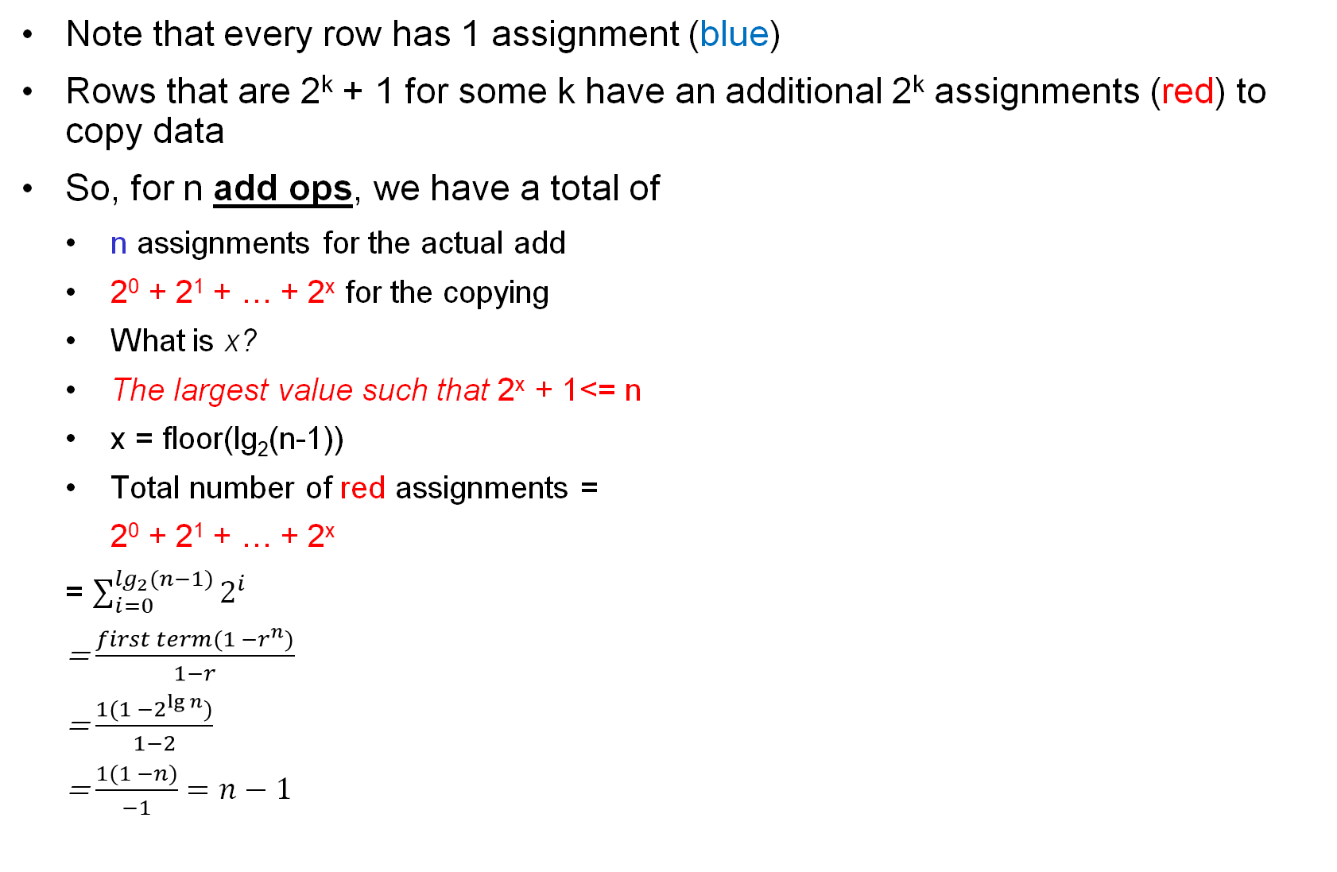
Amortized Analysis Example
Note that every row has 1 assignment (blue)
Rows that are 2^{k} + 1 for some k have an additional 2^{k} assignments (red) to copy data
So, for n add ops, we have a total of
n assignments for the actual add
2⁰ + 2¹ + … + 2^{x} for the copying
What is x?
The largest value such that 2^{x} + 1<= n
x = floor(lg₂(n-1))
Total number of red assignments =
2⁰ + 2¹ + … + 2^{x}
= $\sum_{i=0}^{\lg_{2}⁡(n−1)}{2^{i}}$
= $\frac{first term(1 −r^{n})}{1−r}$
= $\frac{1(1 −2^{\lg{n}})}{1−2}$
= $\frac{1(1 −n)}{−1}=n−1$
Insert #
# of assignments
End array
size
1
1
1
2
2 =
1 + 1 =
1 + 2⁰
2
3
3 =
1
+
2
1
4
4
1
4
5
5 =
1
+
2
2
8
…
1
8
9
9 =
1
+
2
3
16
…
1
16
17
17 =
1
+
2
4
32
…
1
32
32
1
32

Slide 27
Amortized Analysis
Total number of assignments is n + (n-1) = 2n-1 → O(n)
Since we did n add() operations overall, our amortized time is O(n)/n = O(1), a constant
Recall that when increasing by 1 we had O(n) amortized time
Note how much better our performance is when we double the array size
Ok, that one was a bit complicated
Had a good deal of math in it
But that is what algorithm analysis is all about
If you can do some math you can save yourself some programming!

Slide 28
Amortized vs. Average-case Analysis
Amortized running-time is average over a sequence of operations
useful when the operations have varying running-time
e.g., add() is O(1) without array resizing and O(n) when resizing happens
Average-case running-time is average over a probability distribution of the input
Typically, a uniform distribution is assumed
e.g., assume all array positions have the same probability of holding the target item in search

Slide 29
Amortized Analysis Useful When …
… the running-time of a method varies independently of the values of the input
e.g., add() in ResizableArrayBag:
O(1) if the array is not full; O(n) when the array is full
these cases are independent of the values of the items in the array

Slide 30
The ADT Queue
A queue is another name for a waiting line
Used within operating systems and to simulate real-world events
Come into play whenever processes or events must wait
Entries organized first-in, first-out

Slide 31
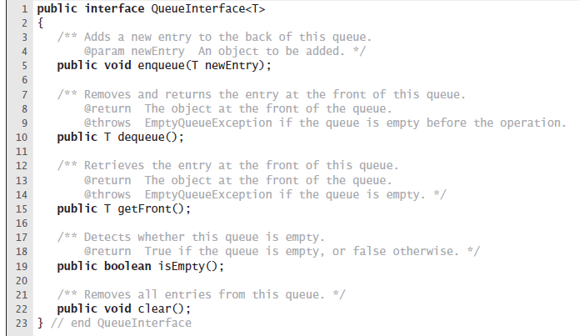
The ADT Queue Interface

Slide 32
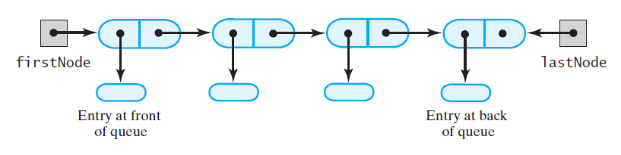
Linked Implementation of a Queue

Slide 33
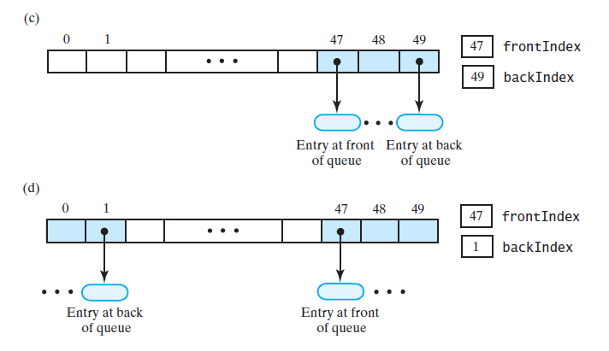
Circular-Array Implementation of a Queue
An array that represents a queue: (c) after several additions, removals; (d) after two more additions that wrap around to beginning of array

Slide 34
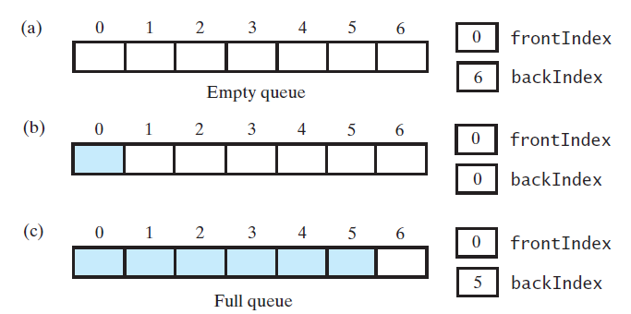
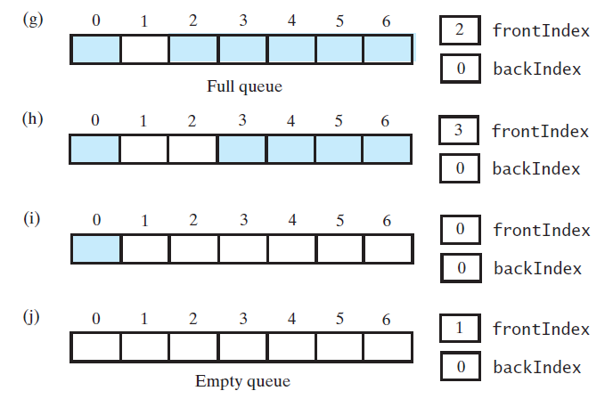
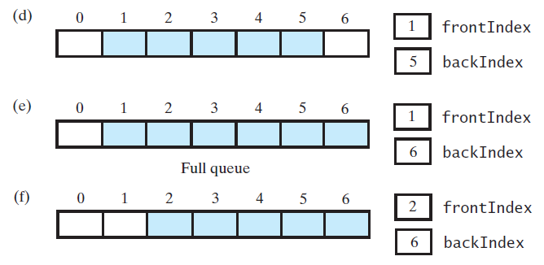
Circular-Array with One Unused Location
A 7-location circular array holding at most six entries

Slide 35
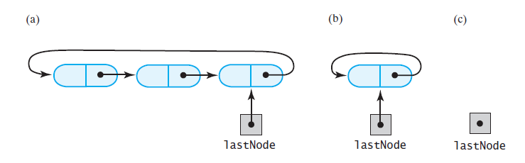
Circular-Linked Implementations of a Queue
A circular linked chain with only last-node reference
has more than one node
has one node
is empty

Slide 36
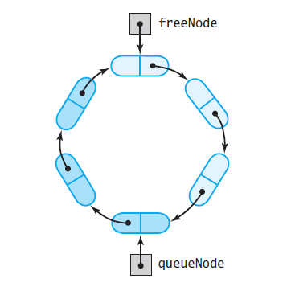
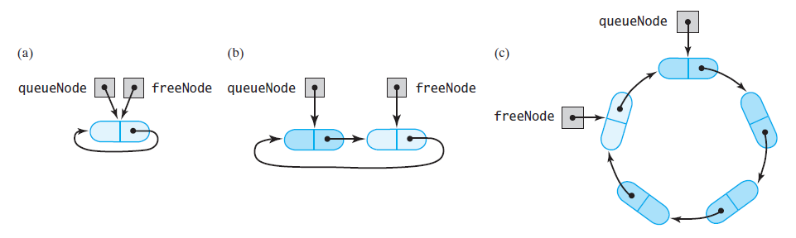
Two-Part Circular Linked Chain
A two-part circular linked chain that represents:
a queue and
nodes available
Empty
after adding one entry
after adding three more entries

Slide 37
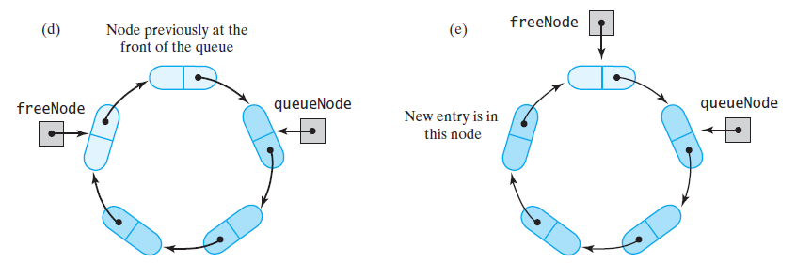
Two-Part Circular Linked Chain
A two-part circular linked chain that represents a queue: (d) after removing the front entry; (e) after adding one more entry

Slide 38
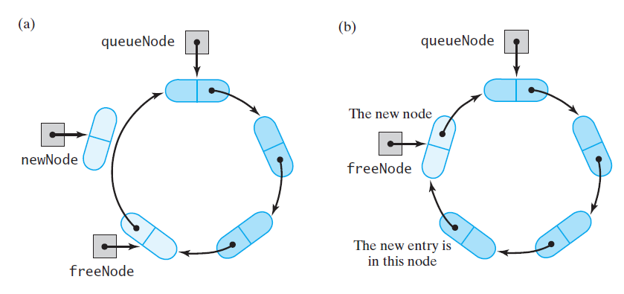
Two-Part Circular Linked Chain
A chain that requires a new node for an addition to a queue: (a) before the addition; (b) after the addition

Slide 39
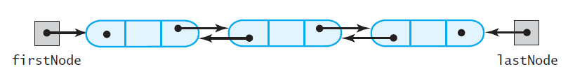
Doubly-Linked Implementation of a Deque
A doubly linked chain with head and tail references

